Slide 1
COM 398 Systems Security
Course Work 2
By Artom Kovalenko B00974470

Slide 2

Explanation of TCP/IP protocols suit
Transmission Control Protocol(TCP) – The transport-layer protocol is one of the TCP/IP protocols which responsible for reliable delivery.
It creates a logical connection between of two entities in various systems and each entity keeps tracking of incoming and outgoing segment to both entities to control the flow of segments and to recover damages segments or loosing them.
User Datagram protocol (UDP) – Is another transport-level protocol of TCP/IP protocol suit. It used to send the datagrams and packets to hosts on Internet Protocol but unlike TCP, it does not keep records of what has sent, so it makes UDP to not have a guarantee to deliver, preservation of sequence, or protection against of duplications.
UDP has a minimum usage of protocol mechanisms while processes and some transaction-oriented applications make use of it

Slide 3
Explanation of TCP/IP protocols suit
Internet Protocol (IP) – Network layer-protocol which responsible for routing function through the networks. It used to implement in end systems and routers. Its task to deliver packets from one host (source) to another host(destination) and which depends on the packet headers at IP addresses.
The difference between the TCP and IP is that TCP is responsible for safety of the incoming and outgoing data by tracking, error-checking and ordering it. While IP is responsible only for routing data between the network.

Slide 4
The work of the TCP 3-Way Handshake Process
This method TCP uses to establish the connection.
By sending a SYN packet to the server, a client system requests a TCP connection; this allows server to determine the client's address, port number, and initial sequence number. The server will respond to the client with a SYN-ACK packet, which includes a sequence number for the server and increases the client's sequence number to confirm receipt of the SYN packet, because it holds records of all known TCP connections. The connection will be regarded as established once the client sends the ACK packet back to the server with an updated server sequence number.

Slide 5
DoS, DDoS and its subtypes
Denial-Of-Service (DoS) – an attack from a single source designed to machine or network in order overwhelming it with traffic or exploiting vulnerabilities by sending a lot of requests.
Distributed Denial-Of-Service (DDoS) – an attack from many sources designed to overload with many requests machine or network. Sometimes using infected machines or “zombie” machines to send traffic to the target which makes more difficult to track the host of attack and get attack defensed.
Subtypes:
Volumetric attacks – attacks by flooding the target's bandwidth with an enormous amount of data
Protocol attacks – attack that exploits vulnerabilities of network protocols to exhaust a server’s resources
Application-layer attacks – certain application or services, with the goal of crashing them by sending them too many requests that appear to legitimate.

Slide 6
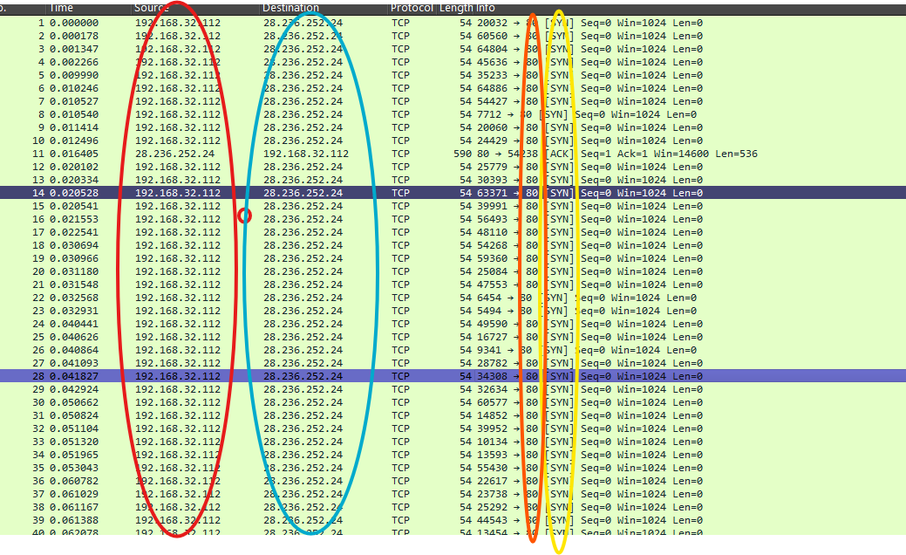
Identifying the type of the attack
The highlighted fields show the attacker IP, target IP, destination port, and TCP flags indicating repeated SYN packets.”
By looking on the file in wireshark I can see communication between two addresses (192.168.32.112 and 28.236.252.24) that means that attack was only from 1 host.
The attack host (192.168.32.112) tries to overwhelm target host (28.236.252.24) with sending many SYN Packets to the Port 80 in a small amount of time
Attack type: DoS (SYN request flood)
Attacker IP address: 192.168.32.112
The reason why this attack was possible can be: An open network service without was not secured and attacker was able to find the vulnerability,
the router or firewall didn’t have rate limiting set up which helps the attacker to spam with SYN packets
the attacker has access to network of the target or target’s machine is infected with malware, backdoor for example.
For countermeasure, I would turn on the SYN-cookies which would make the server not to maintain the half-open connection
Update the system or hardware if outdated
Install IDS/IPS wich will identify the anomalies like large amount of SYN packets and will block these connections.
Red circle – the IP address of attacker
Blue circle – the IP address of the target
Orange circle – show the port number is being attacked
Yellow circle – type of packet was sent to the target

Slide 7
Thank you
References
Computer Security: Principles and Practice, Global Edition by William Stallings and Lawrie Brown

